Slide 1

InsurAI – Corporate Policy Automation and Intelligence System
Team Members
1.Jeevan P Naik
2.Sreeja Thota
3. Vedha Kavya Sudha Perni
4.Yashwanth M P
5. Divyasri PE

Slide 2
Project Overview
InsurAI is an enterprise-grade insurance management platform that streamlines and automates corporate policy workflows. It provides intelligent tools for policy administration, risk assessment, claims processing, and compliance, enabling organizations to manage insurance portfolios efficiently and insightfully.

Slide 3
Key Highlights
Web-based application
MySQL database
Scalable design
Using React.js for frontend and Spring Boot for backend
For structured storage
For large enterprises with thousands of employees
Role-based access
Real-time capabilities
Employee, Agent, HR Admin, and System Admin
Provides real-time updates, automated workflows, AI-powered fraud detection, and comprehensive dashboards

Slide 4

Problem Statement
Currently, corporate insurance management suffers from manual inefficiencies:
Employees submit claims through forms or emails
HR and insurance agents manually verify policies and eligibility
Delays in claim approvals and approval errors are common
Employees cannot track claim statuses in real time
Lack of automated fraud detection results in financial losses
Administrative overhead increases operational costs
Project Objective
The system aims to simplify policy management for employees and HR, speed up claim approvals via automation, provide transparency with real-time claim tracking, reduce fraud with AI-driven anomaly detection, and generate insights and reports for HR/Admin to improve decision-making.

Slide 5
Scope
Existing System / Current Practices
Focused on corporate users, not individual policyholders.
Claims submitted manually via forms or emails
Supports role-based access: Employees, Agents, HR Admin, System Admin.
HR and agents verify documents manually
Claim delays due to paperwork and communication gaps
Core functions include policy renewals, claim approvals, tax compliance, reporting, fraud detection, analytics and dashboards.
Employees cannot track claims
Fraud detection is absent → companies lose money on false claims
Scalable for organizations of any size.

Slide 6





Proposed System – InsurAI Solution
A web-based corporate insurance management platform integrating automation and intelligence.
Features:
Role-Based Logins
Automation
Employee, Agent, HR, Admin
Auto policy renewals
Auto claim eligibility checks
Scheduled automated reports
Automated Notification
AI & Analytics
Transparency
Fraud detection: duplicate claims, high amounts, suspicious patterns
Real-time claim tracking
Predictive insights for HR/Admin
Automated notifications (email/SMS)

Slide 7





System Users & Roles
Employee
Agent
Register/Login
Manage employee queries (pre-claim questions)
View policy details
Assist employees with claim submission
Submit claims
Update availability (Available/Unavailable)
Upload supporting documents
Track claim status
HR Admin
System Admin
Add/manage employees
Manage all roles (Admin, HR, Agent, Employee)
Approve or reject claims
Configure system settings and tax rules
Manage policies (view, edit, assign)
Monitor fraud detection (duplicate claims, high amounts, suspicious patterns)
Generate reports (claims, policies, analytics)
Oversee system configuration and security
AI & Analytics (System/Automation Layer)
Fraud detection (auto-check claims for duplicates, suspicious patterns, high amounts)
Predictive insights for HR/Admin (claim trends, policy usage)
Real-time claim tracking and status updates
Automated notifications (email/SMS alerts for status changes or fraud alerts)

Slide 8








System Features (Detailed)
1️⃣ Authentication & Registration
2️⃣ Employee Portal
Secure login with JWT authentication
Submit and track claims
Role-based access control for Admin, HR, Agent, Employee
Upload supporting documents
View policy details and benefits
Ask queries to Agents (via chat/messages or chatbot support)
3️⃣ Agent Management
4️⃣ HR Dashboard
Agents register and update availability (Available/Unavailable)
Manage employee insurance data
Handle employee queries (pre-claim or post-claim)
Approve/reject claims based on fraud alerts
Dashboard to track pending and resolved queries
Generate scheduled and on-demand reports
Review AI-generated fraud alerts
5️⃣ Admin Dashboard
6️⃣ Automation
Manage roles and permissions for all users
Auto-reminders for policy renewals
Configure tax rules and system settings
Auto eligibility checks for claims
Monitor fraud alerts and system health
Scheduled report generation and notifications
Configure automation rules (e.g., reminders, auto-checks)
7️⃣ AI & Analytics
8️⃣ Reports & Analytics
Fraud detection using anomaly detection (duplicates, unusual amounts, suspicious patterns)
PDF/Excel reports for claims, policies, and fraud alerts
Predictive analytics for HR/Admin (policy trends, claim patterns)
Visual dashboards (charts, graphs) for quick insights
Real-time alerts for suspicious claims
Downloadable audit logs for compliance and tracking

Slide 9
Modules Breakdown
1️⃣ Login & Registration Module
Secure login with JWT authentication
Role-based access control for Admin, HR, Agent, Employee
Employee self-registration and profile management
2️⃣ Policy Management Module
Add, update, and view company insurance policies
Technology Stack
Employees can view policy details and download PDFs
Frontend
React, CSS, Bootstrap
HR/Admin can assign policies to employees and manage statuses
3️⃣ Claim Management Module
Backend
Java, Spring Boot, Spring Data JPA
Employees submit claims and upload supporting documents
Database
MySQL
Automated eligibility and fraud checks (duplicates, unusual amounts)
Authentication
JWT, Spring Security
HR reviews and approves/rejects claims
Automation
Spring Scheduler
Real-time status updates reflected to Employee, HR, and Admin dashboards
Fraud Detection / AI / Analytics
Rule-based logic, Cohere API, Predictive Analytics, Dashboard Visualization
4️⃣ Agent Management Module
File Storage
Supabase S3 / AWS S3
Track agent availability (Available/Unavailable)
Manage employee queries and interactions
Email / Notifications
SMTP
Agents respond to pre-claim and claim-related questions
Testing
Post
5️⃣ Admin Dashboard Module
Deployment (Future)
Docker, Cloud (AWS/Azure)
Manage roles and permissions (Admin, HR, Agent, Employee)
Monitor fraud alerts and system health
Configure automation rules (notifications, reminders)
6️⃣ Reports & Analytics Module
Automated report generation (PDF/Excel) for claims, policies, and fraud alerts
AI-powered insights and predictive analytics for HR/Admin
Visual dashboards with charts, graphs, and real-time metrics

Slide 10

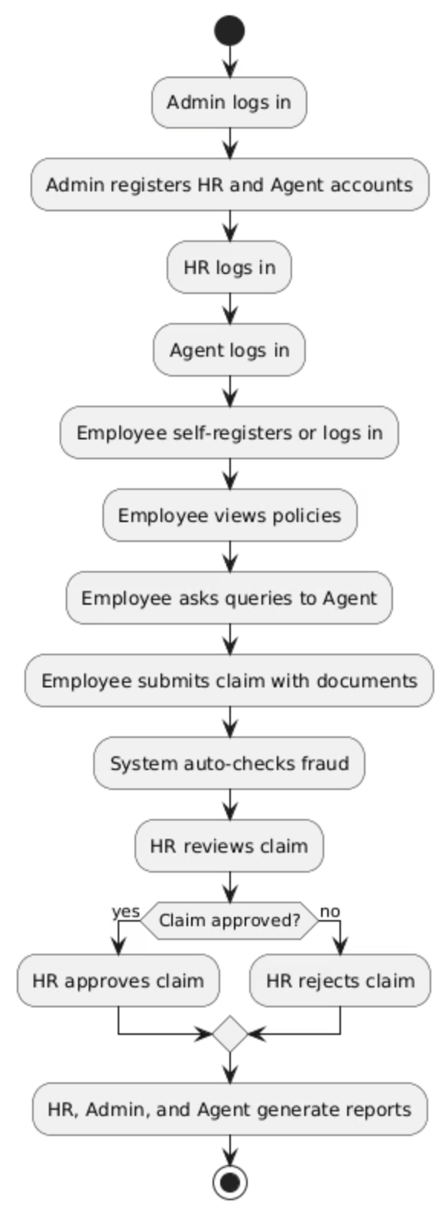








Workflow Example
Admin logs in → registers HR/Agent
HR logs in → Agent logs in
Employee self-registers/logs in
Employee views policies → asks Agent queries
Employee submits claim with documents
System auto-checks fraud
HR reviews → approves/rejects
HR/Admin/Agent generate reports

Slide 11
Advantages, Limitations & Future Scope
Advantages
Future Scope
Employees: Faster claims, transparency, real-time updates
HR: Reduced workload, automated reporting
Mobile apps (Android/iOS)
Admin: Full control, fraud detection, compliance
For employees
Company: Cost reduction, scalable and trusted solution
Limitations
Integration
Web-only (mobile app planned in future)
With insurance companies and hospitals
AI fraud detection initially rule-based; ML models will enhance accuracy
Integration with external insurance providers pending
AI chatbot
Requires internet connectivity
For employee support
Blockchain
For secure claim history
Cloud deployment
For large-scale use

Slide 12
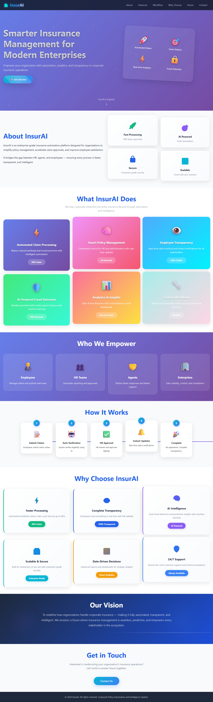
Screenshots

Slide 13


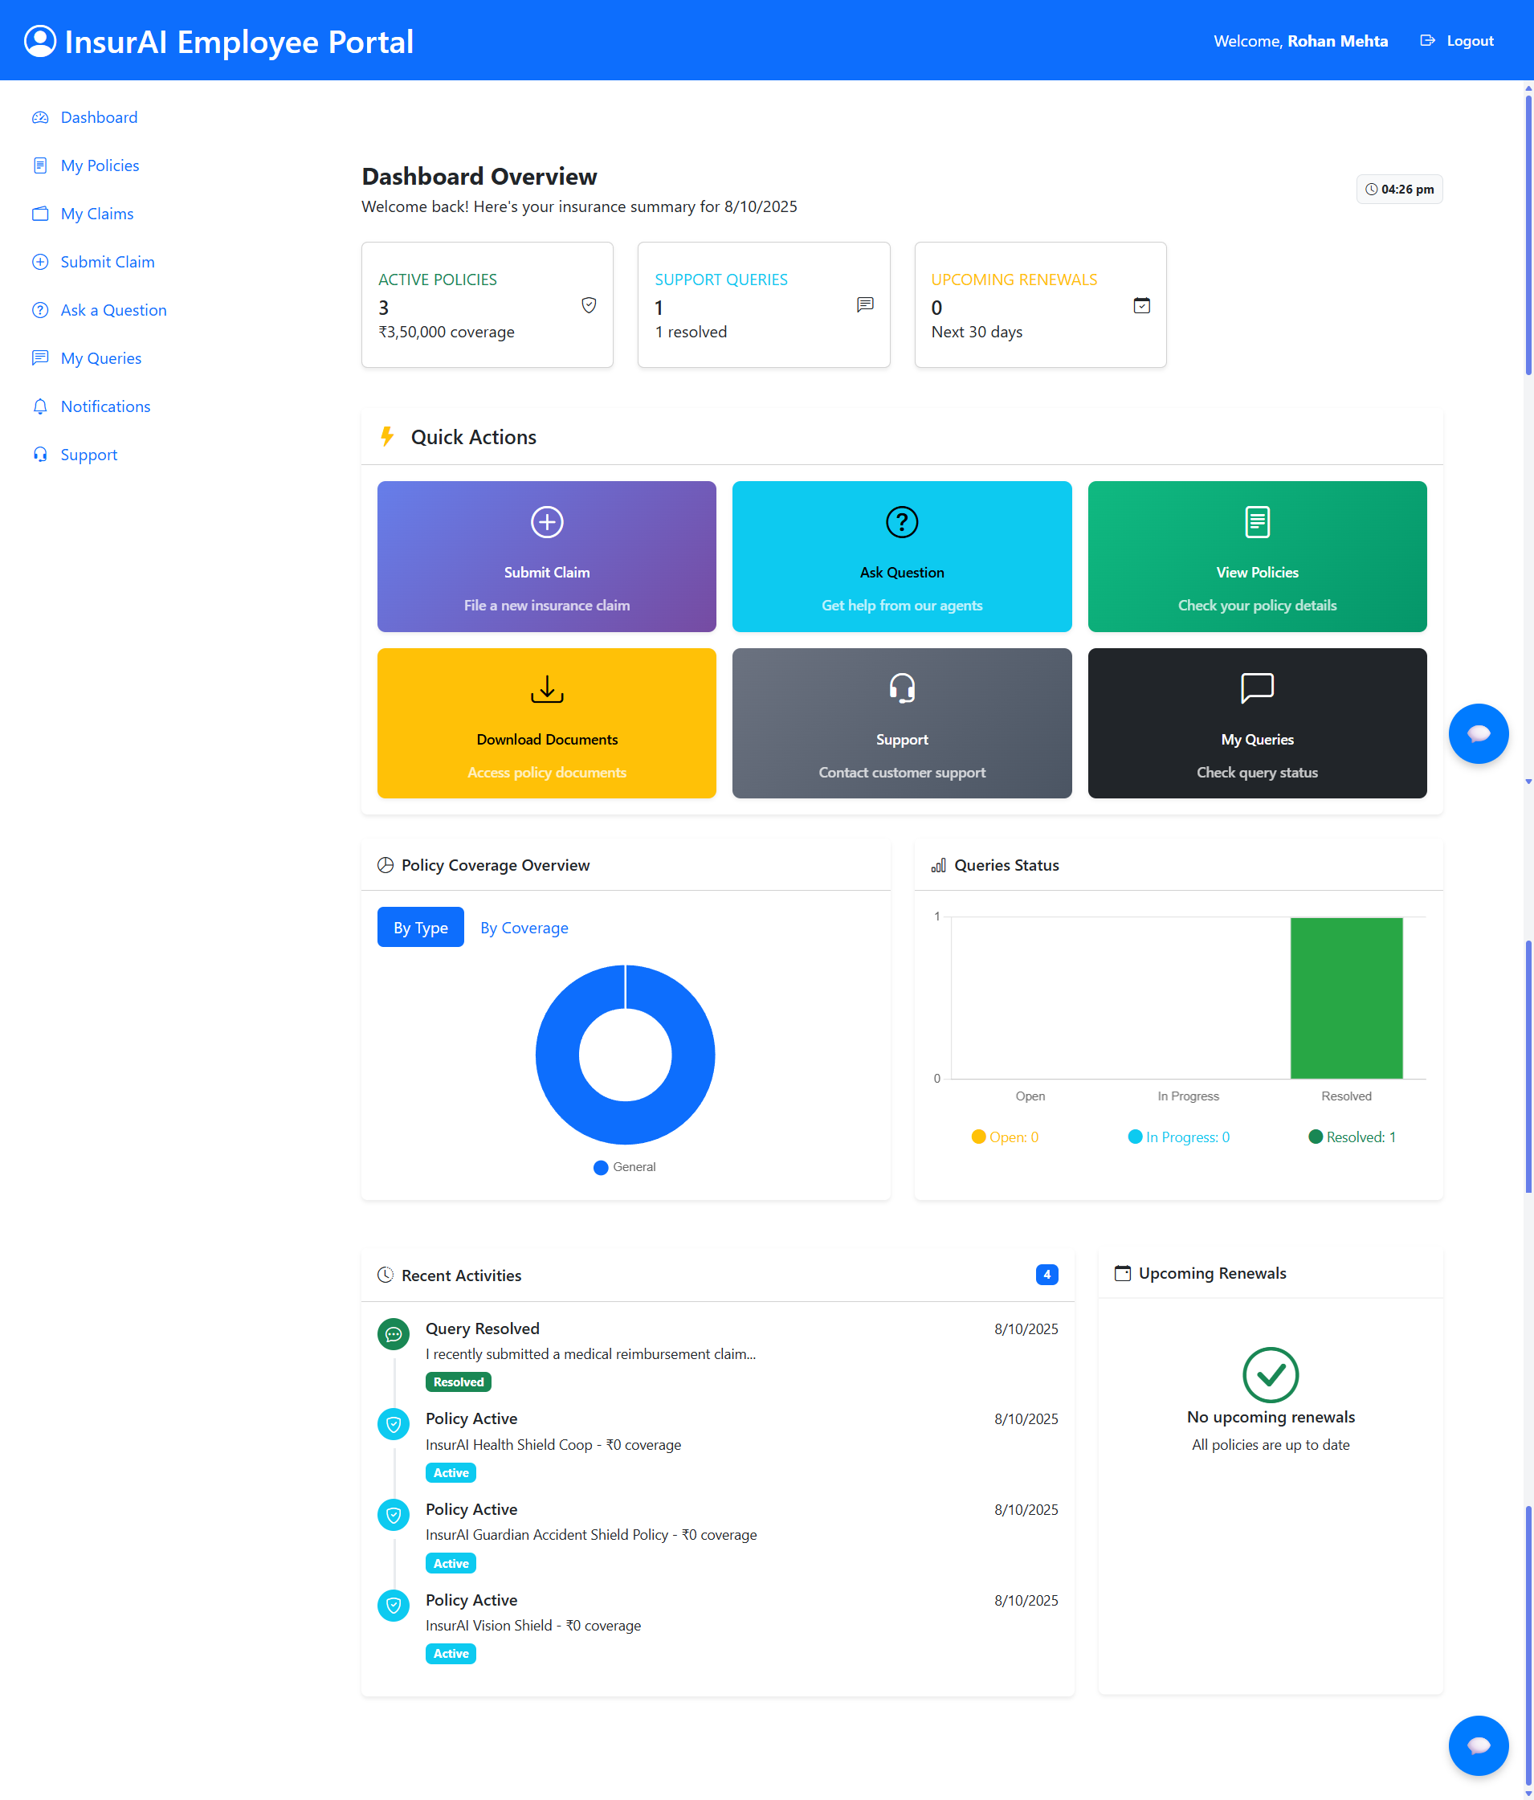
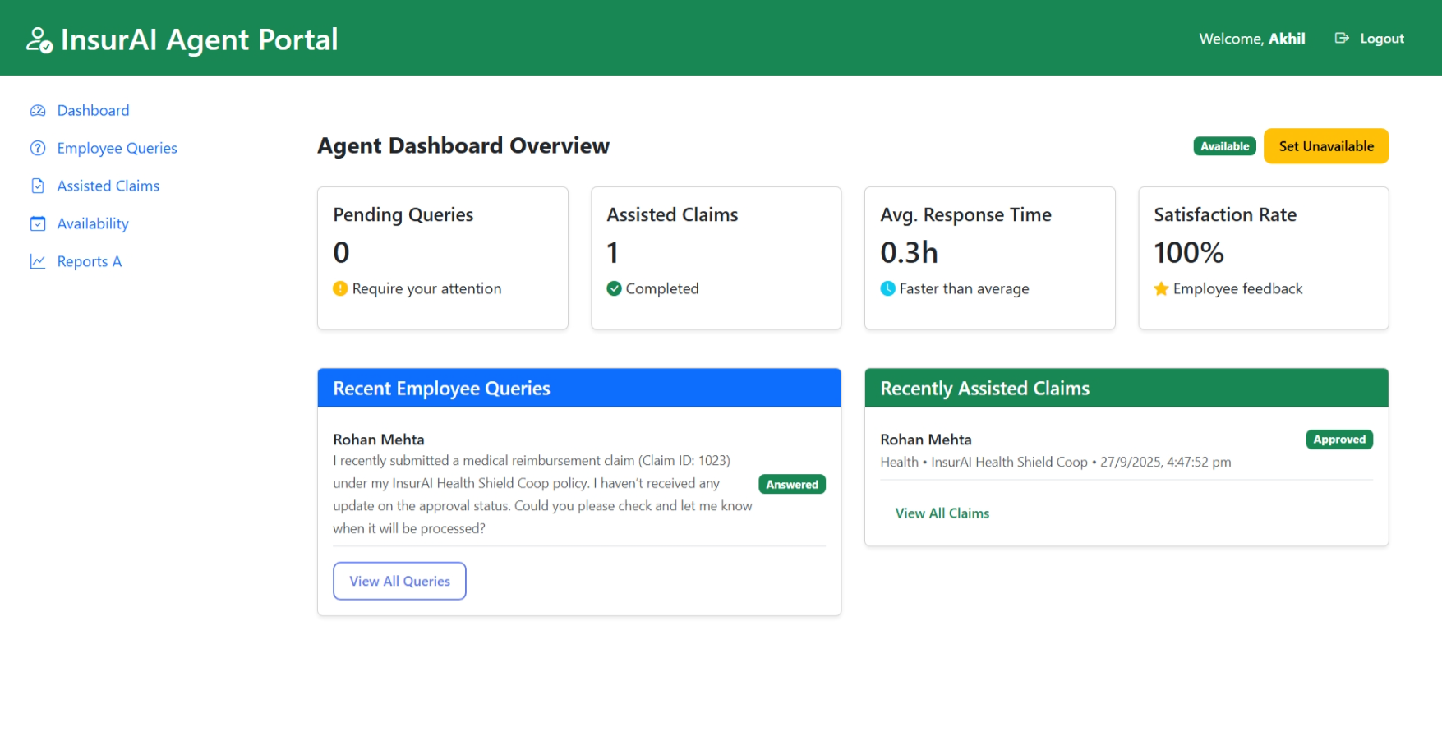
Employee Dashboard
Agent Dashboard

Slide 14


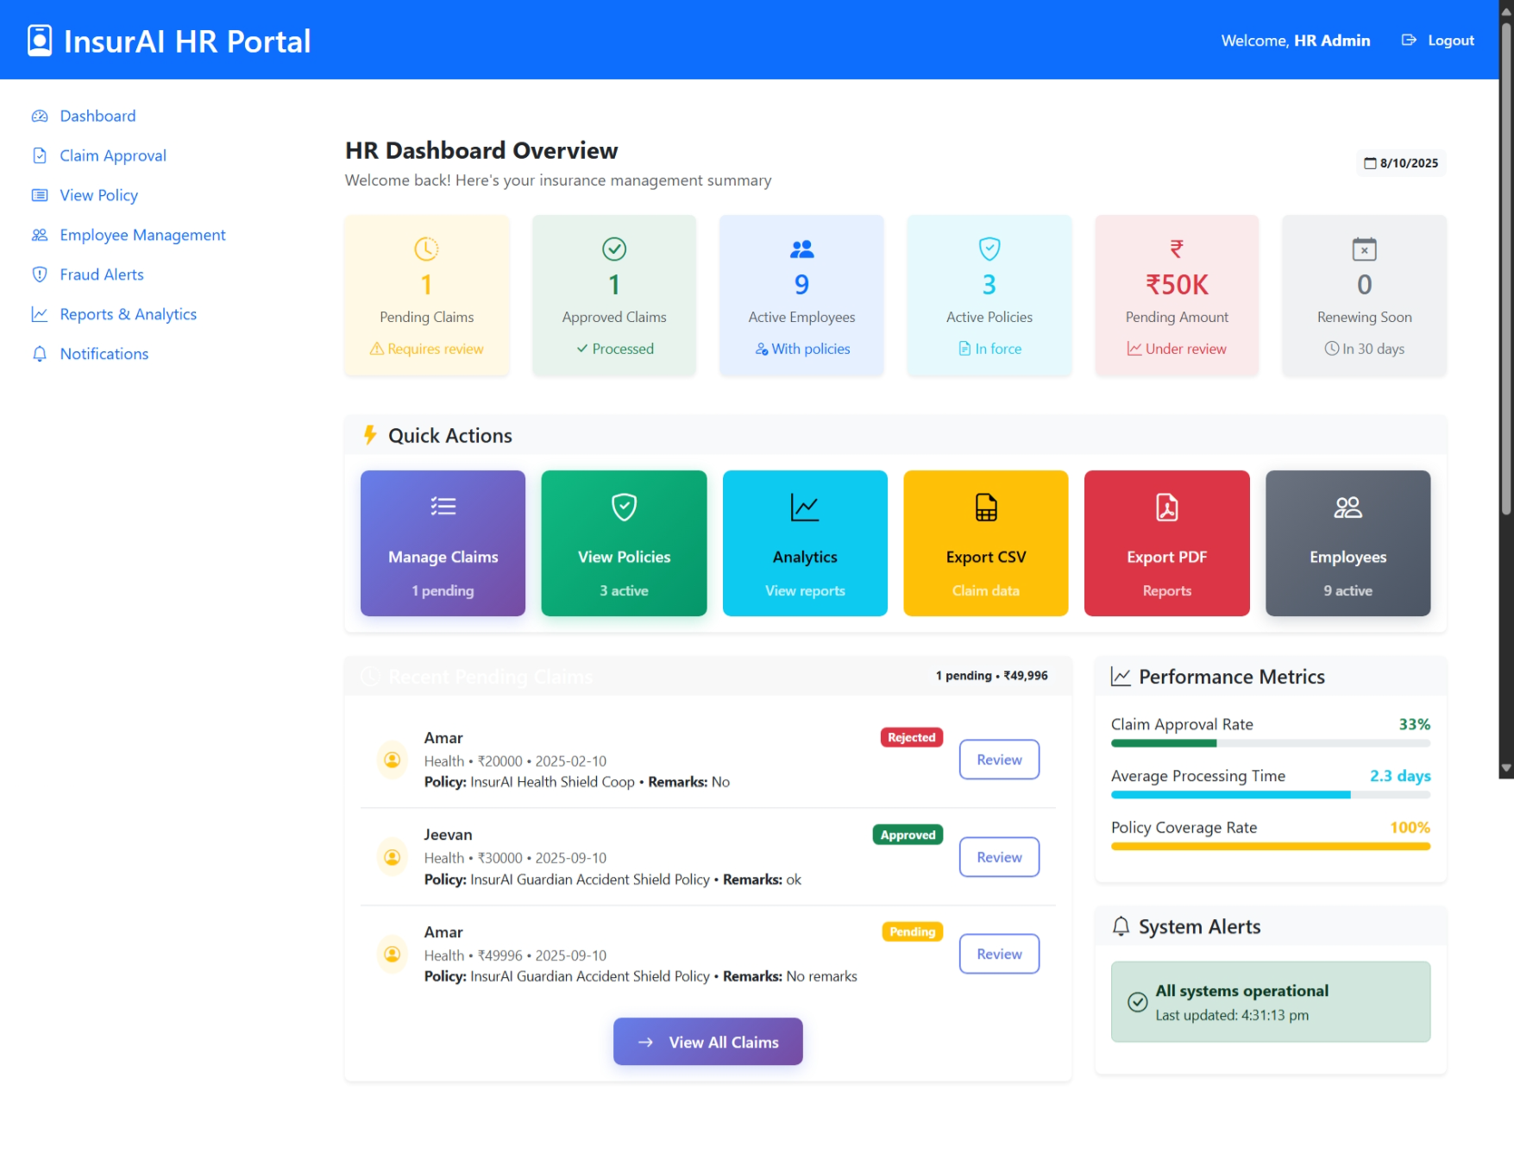
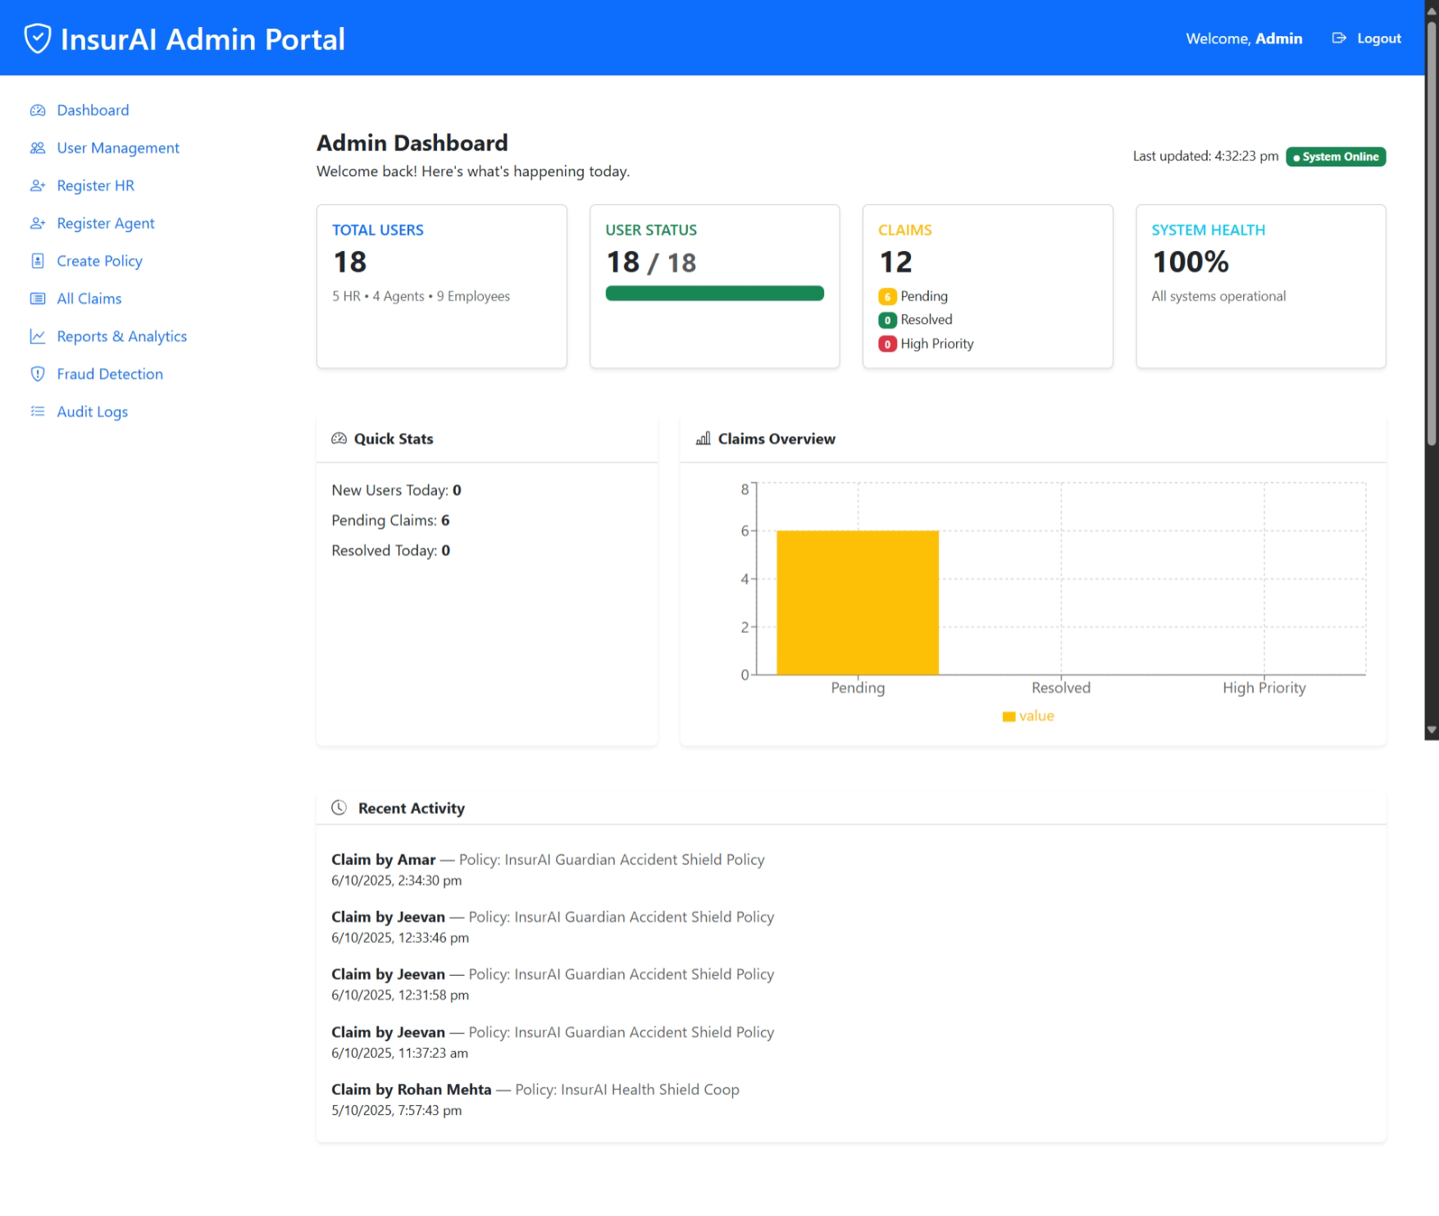
HR Dashboard
Admin Dashboard

Slide 15

Conclusion
InsurAI emerges as a comprehensive, enterprise-grade solution poised to revolutionize the insurance claims process. By leveraging advanced technology, it delivers substantial value across the organization:
Enhanced Efficiency: Streamlines claims management, significantly reducing workload for HR and admin staff.
Unparalleled Transparency: Offers real-time updates and clear visibility for employees, fostering trust and satisfaction.
Robust Control & Compliance: Provides administrators with full oversight, advanced fraud detection, and ensures regulatory adherence.
Strategic Growth: Delivers cost savings, scalability, and a trusted platform, supporting the company's long-term objectives.
Future-Proofing: With planned mobile integrations, advanced AI capabilities, and blockchain security, InsurAI is designed for continuous evolution and adaptation to emerging needs.
InsurAI is more than just a tool; it's a strategic partner for businesses aiming for a smarter, more secure, and employee-centric future in insurance claims management.

Slide 16
Thank You

